Slide 1
Preliminaries in Machine Learning Some Terminology

Slide 2
Inputs-Weights-Outputs
Lowercase boldface letters are used for vectors and uppercase boldface letters for matrices.
A vector x has elements (x₁, x₂, . . . , x_{m}).
An input vector is the data given as one input to the algorithm. Written as x, with elements x_{i}, where i runs from 1 to the number of input dimensions, m.
Weights w_{ij} , are the weighted connections between nodes i and j. They are arranged into a matrix W.

Slide 3
The output vector is y, with elements y_{j} , where j runs from 1 to the number of output dimensions, n. We can write y(x,W) to show that the output depends on the inputs to the algorithm and the current set of weights of the network.
The target vector t, with elements t_{j} , where j runs from 1 to the number of output dimensions, n, are the extra data that we need for supervised learning, since they provide the ‘correct’ answers that the algorithm is learning about.

Slide 4
Activation Function: For neural networks, g(·) is a mathematical function that describes the firing of the neuron as a response to the weighted inputs, such as the threshold function
Error E: a function that computes the inaccuracies of the network as a function of the outputs y and targets t.

Slide 5
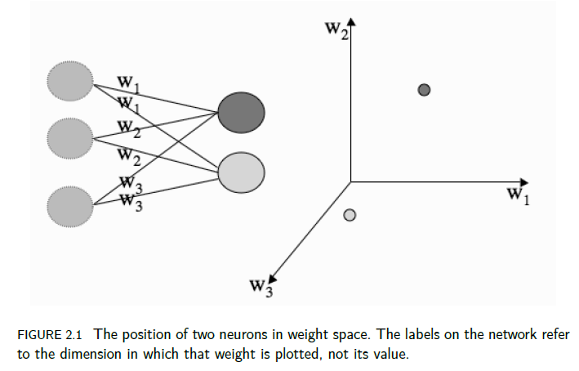
Weight Space

Slide 6
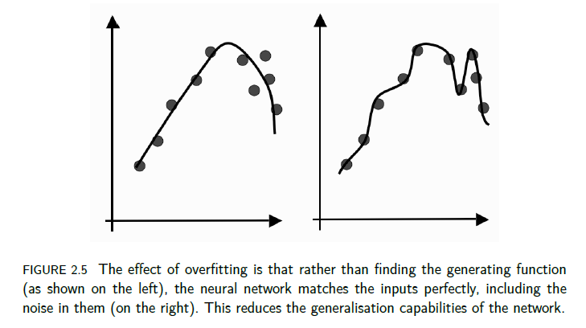
Overfitting vs. Generalization

Slide 7
Experimental Design
A couple of potential problems…
How to get most out of limited data set?
Why are these things concerns?
When we partition match set, might get biased training/test sets, and …
… more data is always “more better”
Cross validation solves these problems.

Slide 8
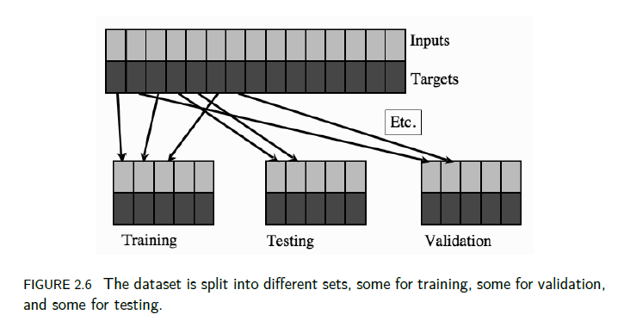
Training, Testing, and Validation Sets

Slide 9

Training-Validation
Train your algorithm on the training set multiple times, each time using different values for the parameters you wish to optimise.
For each trained classifier evaluate the performance on the
validation set (using the performance measure you have selected).
Keep the classifier that leads to the maximum performance on the validation set (in this example the one trained with 35 hidden neurons)
This is called parameter (hyperparameter) optimization, since you select the set of parameters that have produced the best classifier.

Slide 10
Training/Validation/Test Sets
Test the performance on the test set.
The test set should NOT be used for training or validation. It is used
ONLY in the end for estimating the performance on unknown examples,
i.e. how well your trained classifiers generalises.
You should assume that you do not know the labels of the test set and only after you have trained your classifier they are given to you.

Slide 11
n-Fold Cross Validation
Partition match set into n equal subsets
Denote subsets as S₁,S₂,…,S_{n}
Let training set be S₂∪ S₃∪ … ∪ S_{n}
And test set is S₁
Repeat with training set S₁∪ S₃∪ … ∪ S_{n}
And test set S₂
And so on, for each of n “folds”
Typically, n = 5 or n = 10 is used
Notes:
“Partition” implies that each file is in exactly 1 subset.

Slide 12
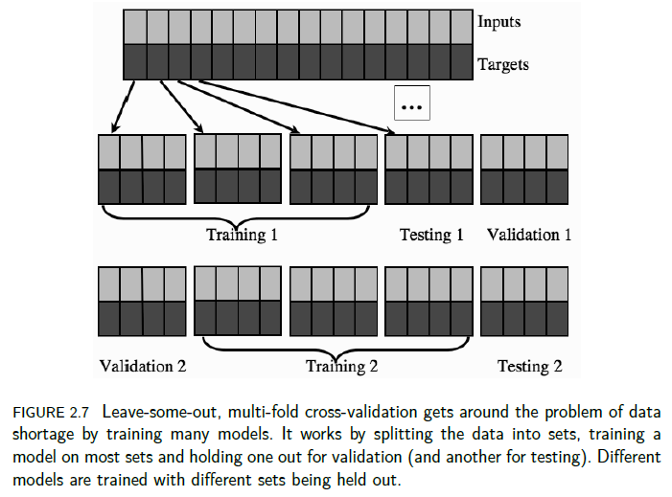

Slide 13
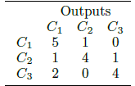
Confusion Matrix
This table tells us that, for the three classes (C₁, C₂, and C₃), most examples were classified correctly, but two examples of class C₃ were misclassified as C₁, and so on.
For a small number of classes this is a nice way to look at the outputs.

Slide 14

Accuracy Measures (1)
For two classes:
The entries on the leading diagonal of this chart are correct and those off the diagonal are wrong, just as with the confusion matrix.
Accuracy is the sum of the number of true positives and true negatives divided by the total number of examples:
Accuracy = (#TN + #TP)/(#TN+#TP+#FN+#FP)

Slide 15
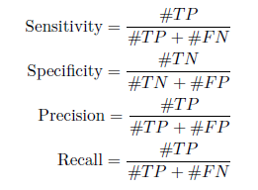
Accuracy Measures (2)
Together, either of these pairs of measures gives more information than just the accuracy.
If you consider precision and recall, then you can see that they are to some extent inversely related, in that if the number of false positives increases (meaning that the algorithm is using a broader definition of that class), then the number of false negatives often decreases, and vice versa.

Slide 16


Accuracy Measures (3)
They can be combined to give a single measure, the F1 measure, which can be written in terms of precision and recall as:

Slide 17
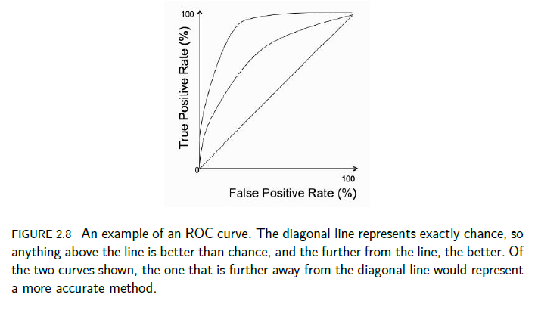
The Receiver Operator Characteristic (ROC) Curve

Slide 18
ROC Curve (1)
A single run of a classifier produces a single point on the ROC plot, and a perfect classifier would be a point at (0, 1) (100% true positives, 0% false positives), while the anti-classifier that got everything wrong would be at (1,0); so, the closer to the top-left-hand corner the result of a classifier is, the better the classifier has performed.
Any classifier that sits on the diagonal line from (0,0) to (1,1) behaves exactly at the chance level (assuming that the positive and negative classes are equally common) and so presumably a lot of learning effort is wasted since a fair coin would do just as well.

Slide 19
ROC Curve (2)
In order to compare classifiers, or choices of parameters settings for the same classifier, you could just compute the point that is furthest from the ‘chance’ line along the diagonal.
However, it is normal to compute the area under the curve (AUC) instead.

Slide 20
ROC Curve (3)
The key to getting a curve rather than a point on the ROC curve is to use cross-validation.
The true labels can be used to produce a ranked list of the different cross-validation-trained results, which can be used to specify the ROC curve that correspond to the results of this classifier.
By producing a ROC curve for each classifier, it is possible to compare their results.

